Slide 1
Sd2.2 team bonding

Slide 2
Opening Prayer
Ms. May Giltendez Pantoja SD2.2 Deputy Department Manager

Slide 3
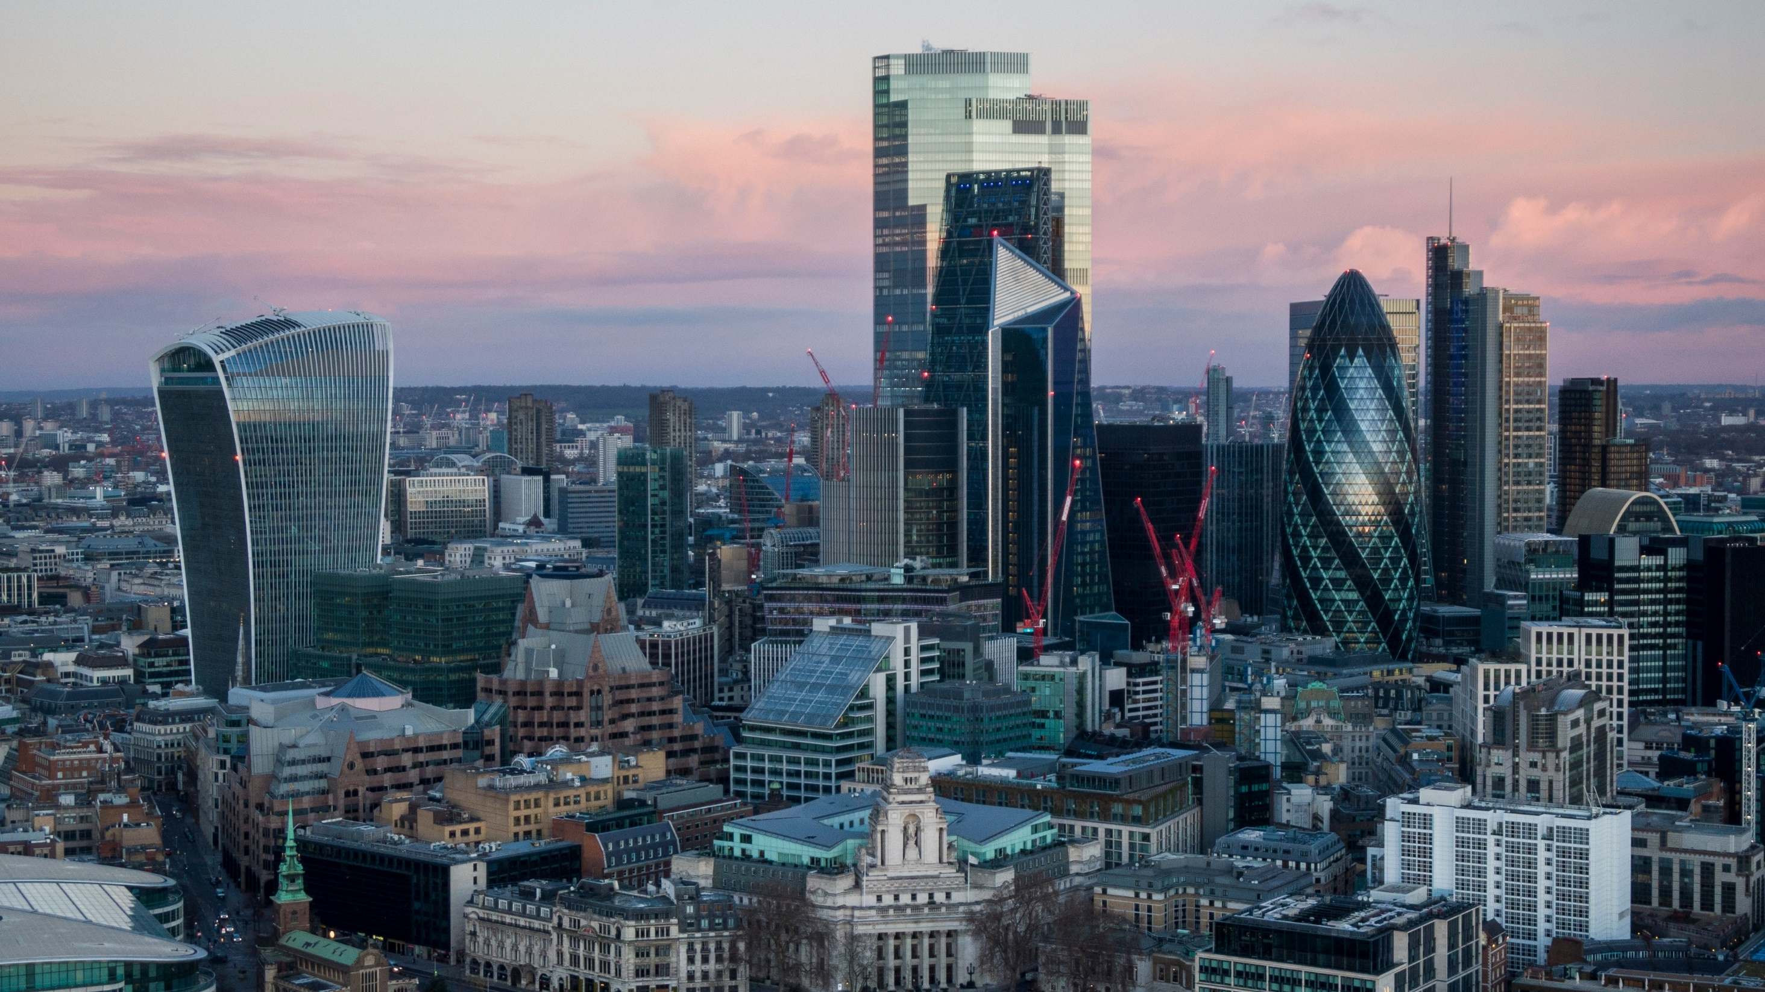
Opening remarks
Mr. Manuel Baricuatro SD2.2 Department Manager

Slide 4
agenda
Manuel Baricuatro Jr. SD4 Dept. Manager

Slide 5
AGENDA
Time | Activity
11:30 AM – 12:30 PM | Lunch
12:30 PM – 3:00 PM | Team Building Activity
3:00 PM – 3:30 PM | Announcement of Winners and Closing
3:30 PM – 7:00 PM | Personal Time
3:30 PM – 7:00 PM | Check-out (Day Use) / Dinner (Overnight)

Slide 6
Lunch

Slide 7
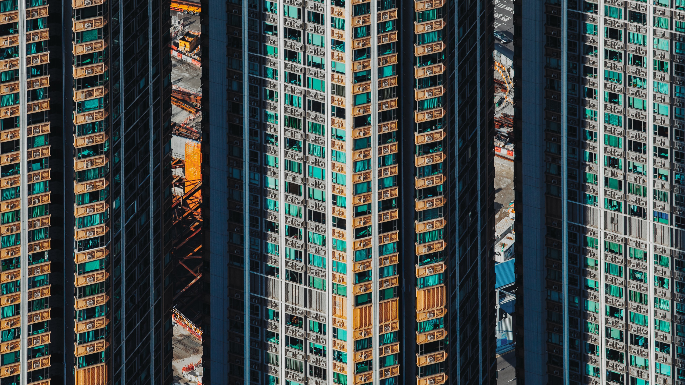
Team building activity

Slide 8
Amazing race
TEAM ACTIVITY
Number of Tasks: 6
Teams: 4 groups with 10 members each
Game Master: Kenneth Raganas
Task Facilitators: GS Offshore Members

Slide 9
Amazing race
TEAM ACTIVITY
Game Flow:
The first task will be announced to all teams at the same time
Task announcement will be done by the host
After completing a task, the facilitator provides a clue or riddle
The clue leads to the next task
The process continues until all six tasks are completed

Slide 10
Announcement of winners

Slide 11
CLOSING remarks
LOUELLA VILLAMORA-LAURON SD42 Manager

